Slide 1
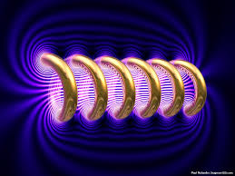
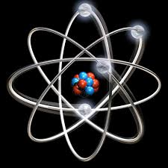

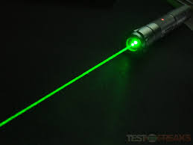
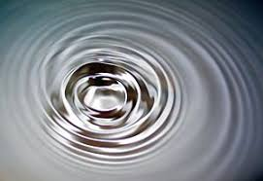
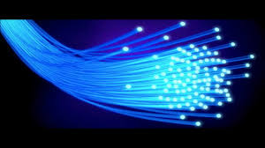
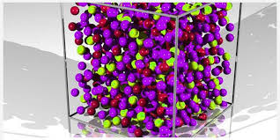
Engineering Physics
PHY-109
LASER
ELECTROMAGNETIC THEORY
QUANTUM MECHANICS
LASER
WAVES
Dr. Vishal Thakur
Department of Physics
Lovely Professional University
Phagwara, Punjab-144411
SOLID STATE PHYSICS
FIBER OPTICS

Slide 2
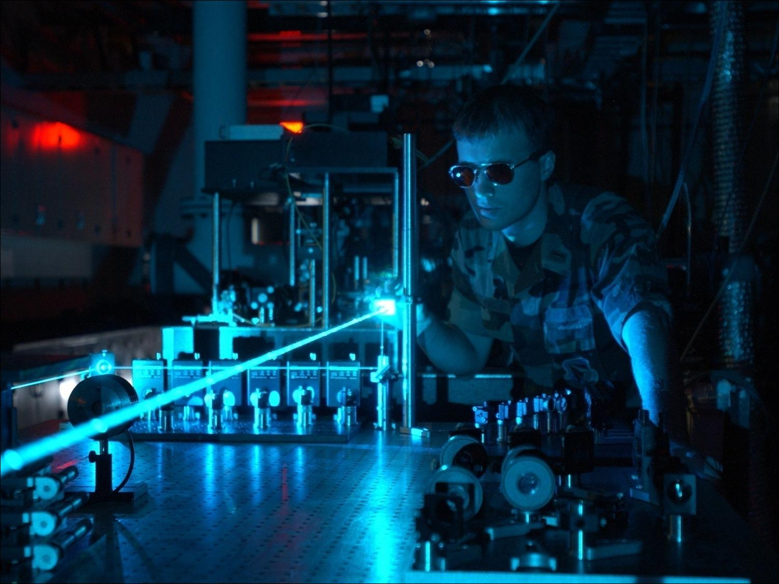
Notes:
2

Slide 3
Syllabus
Fundamentals of laser- energy levels in atoms
Radiation matter interaction, Absorption of light
Spontaneous emission of light, stimulated emission of light
Population of energy levels, Einstein A and B coefficients
Metastable state, population inversion, lasing action
Properties of laser, resonant cavity, excitation mechanisms
Nd - YAG, He-Ne Laser, Semiconductor Laser
Applications of laser in engineering, holography.

Slide 4
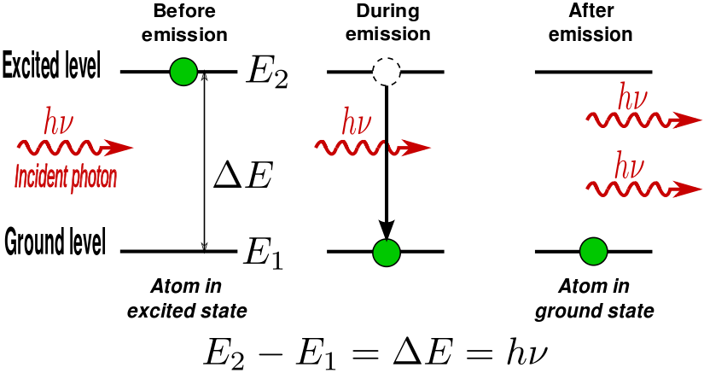
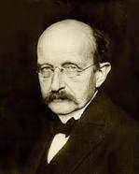
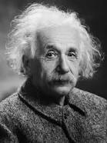
LASER (Light Amplification by Stimulated Emission of radiation)
In his most important work, published in 1900, Planck deduced the relationship between energy and the frequency of radiation, essentially saying that energy could be emitted or absorbed only in discrete chunks – which he called quanta – even if the chunks were very small.
His theory marked a turning point in physics and inspired up-and-coming physicists such as Albert Einstein. In 1905, Einstein released his paper on the photoelectric effect, which proposed that light also delivers its energy in chunks, in this case discrete quantum particles now called photons.
Max Planck
Albert Einstein
History of LASER
http://www.worldoflasers.com/laserhistory.htm
https://www.photonics.com/Article.aspx?AID=42279

Slide 5
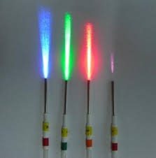
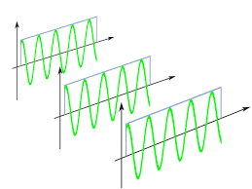
LASER-Definition
It is a device to produce strong, monochromatic, collimated and highly coherent beam of light depending on the principle of stimulated emission of light.
Strong = Intense,
Monochromatic= Having a single wavelength
Collimated= Directed and having low beam divergence
Coherent= Having a constant phase difference among the waves.
Notes:
Pulsed laser have total energy = 50,000 J
Continuous wave laser

Slide 6
LASER-Definition and History
LASER is an outgrowth of MASER (Microwave amplification by stimulated emission of radiation).
First successful ammonia MASER was built by Gordon, Zeiger and Townes in 1954.
In 1958, it was realized by Schawlow and Townes that the concept of MASER can be extended to visible region as well.
In 1960, T. H. Maiman built the first laser using ruby crystal.
In 1961 He-Ne lasers were built by Ali Javan and associates.
After about 20 years semiconductor lasers appeared.

Slide 7
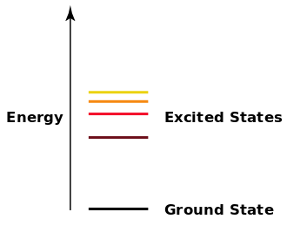
Energy levels in atoms
A quantum mechanical system or particle that is bound—or, confined spatially—can only take on certain discrete values of energy. These discrete values are called energy levels.
This contrasts with classical particles, which can have any energy.
The term is commonly used for the energy levels of electrons in atoms, ions, or molecules, which are bound by the electric field of the nucleus.
The term can also refer to energy levels of nuclei or vibrational or rotational energy levels in molecules.
The energy spectrum of a system with such discrete energy levels is said to be quantized.

Slide 8
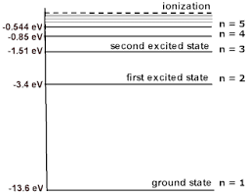
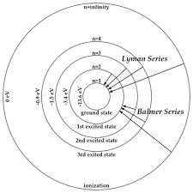
Energy levels in atoms
Potential energy of hydrogen atom is shown in the side figure.
Since electrons are tightly bound to the nuclei, hence, work must be done to take them away from the nuclear boundary.
Since, we are talking about the potential energy of the electrons, hence, they are negative near the nucleus and zero far away from the nucleus.
Thus, potential energy is increased as we go from lower level to higher levels.
Negative potential energy means a bound state.
If an atom, ion, or molecule is at the lowest possible energy level, it and its electrons are said to be in the ground state.
If an atom is at a higher energy level, it is said to be excited, or any electrons that have higher energy than the ground state are excited. The state of the atom is called excited state.

Slide 9
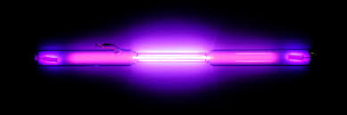
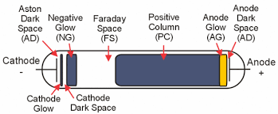
Atomic Excitation: How atoms absorb and emit energy?
There are two main ways in which atoms can be excited to an energy above its ground state and thereby become able to radiate.
By atomic collision
By absorption of photon of definite energy.
By Collision: Discharge tubes
To produce luminous discharge in a rarefied gas, an electric field is established that accelerates the electrons and atomic ions until their kinetic energies are sufficient to excite atoms they collide with. Because energy transfer is a maximum when the colliding particles have the same mass the electrons in such a discharge are more effective than the ions in providing energy to atomic electrons.

Slide 10

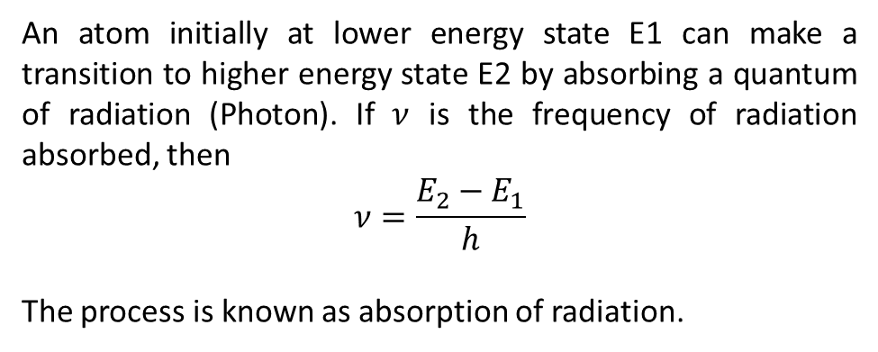




Absorption of light
By Absorption of photon
Before
After
$$E_{2}$$
$$E_{2}$$
$$hν$$
$$E_{1}$$
$$E_{1}$$
An atom initially at lower energy state E1 can make a transition to higher energy state E2 by absorbing a quantum of radiation (Photon). If $ν$ is the frequency of radiation absorbed, then
$$ν=\frac{E_{2}−E_{1}}{h}$$
The process is known as absorption of radiation.
Atom absorbs a quantum of radiation (a photon) and is excited from 1 to 2.
M + hυ → M*
State-1
State-2

Slide 11
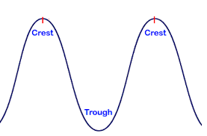
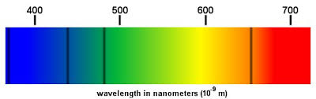
Absorption lines
When white light which contain all the wavelengths is passed through hydrogen gas, photons of those wavelength corresponding to the transition between energy levels are absorbed. The resulting excited hydrogen atoms radiate their excitation energy almost at once, but, these photons come off in random directions. The dark lines in an absorption spectrum are those lines which have been absorbed by the atom.
Atom
Missing ??

Slide 12
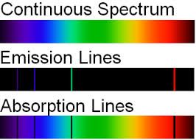

Emission Lines
The emission spectrum of a chemical element or chemical compound is the spectrum of frequencies of electromagnetic radiation emitted due to an atom or molecule making a transition from a high energy state to a lower energy state.

Slide 13
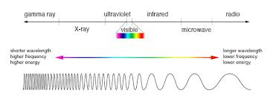
Radiation matter interaction
The different parts of the electromagnetic spectrum have very different effects upon interaction with matter.
Starting with low frequency radio waves, the human body is quite transparent. (You can listen to your portable radio inside your home since the waves pass freely through the walls of your house and even through the person beside you!) As you move upward through microwaves and infrared to visible light, you absorb more and more strongly. In the lower ultraviolet range, all the UV from the sun is absorbed in a thin outer layer of your skin. As you move further up into the x-ray region of the spectrum, you become transparent again, because most of the mechanisms for absorption are gone.
You then absorb only a small fraction of the radiation, but that absorption involves the more violent ionization events. Each portion of the electromagnetic spectrum has quantum energies appropriate for the excitation of certain types of physical processes. The energy levels for all physical processes at the atomic and molecular levels are quantized, and if there are no available quantized energy levels with spacings which match the quantum energy of the incident radiation, then the material will be transparent to that radiation, and it will pass through. If electromagnetic energy is absorbed, but cannot eject electrons from the atoms of the material, then it is classified as non-ionizing radiation, and will typically just heat the material.
http://hyperphysics.phy-astr.gsu.edu/hbase/mod3.html
Notes:
Each portion of the electromagnetic spectrum has quantum energies appropriate for the excitation of certain types of physical processes.
The energy levels for all physical processes at the atomic and molecular levels are quantized, and if there are no available quantized energy levels with spacing, which match the quantum energy of the incident radiation, then the material will be transparent to that radiation, and it will pass through.
If electromagnetic energy is absorbed, but cannot eject electrons from the atoms of the material, then it is classified as non-ionizing radiation, and will typically just heat the material.

Slide 14
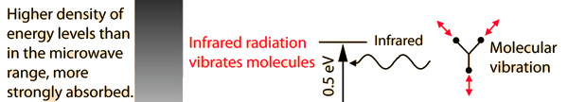

Radiation matter interaction
Microwave Interactions
The quantum energy of microwave photons is in the range 0.00001 to 0.001 eV which is in the range of energies separating the quantum states of molecular rotation and torsion. The interaction of microwaves with matter other than metallic conductors will be to rotate molecules and produce heat as result of that molecular motion. Conductors will strongly absorb microwaves and any lower frequencies because they will cause electric currents which will heat the material. Most matter, including the human body, is largely transparent to microwaves. High intensity microwaves, as in a microwave oven where they pass back and forth through the food millions of times, will heat the material by producing molecular rotations and torsions. Since the quantum energies are a million times lower than those of x-rays, they cannot produce ionization and the characteristic types of radiation damage associated with ionizing radiation.
Infrared Interactions
The quantum energy of infrared photons is in the range 0.001 to 1.7 eV which is in the range of energies separating the quantum states of molecular vibrations. Infrared is absorbed more strongly than microwaves, but less strongly than visible light. The result of infrared absorption is heating of the tissue since it increases molecular vibrational activity. Infrared radiation does penetrate the skin further than visible light and can thus be used for photographic imaging of subcutaneous blood vessels.

Slide 15
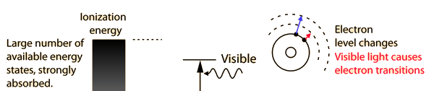
Radiation matter interaction
Visible Light Interactions
The primary mechanism for the absorption of visible light photons is the elevation of electrons to higher energy levels. There are many available states, so visible light is absorbed strongly. With a strong light source, red light can be transmitted through the hand or a fold of skin, showing that the red end of the spectrum is not absorbed as strongly as the violet end.
While exposure to visible light causes heating, it does not cause ionization with its risks. You may be heated by the sun through a car windshield, but you will not be sunburned - that is an effect of the higher frequency UV part of sunlight which is blocked by the glass of the windshield.

Slide 16
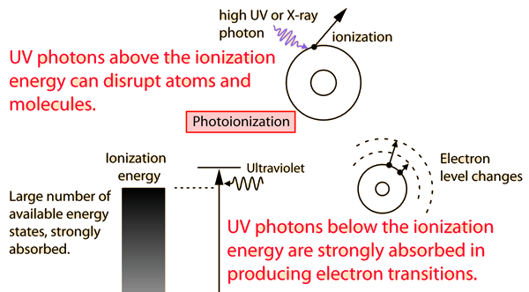
Radiation matter interaction
Ultraviolet Interactions
The near ultraviolet is absorbed very strongly in the surface layer of the skin by electron transitions. As you go to higher energies, the ionization energies for many molecules are reached and the more dangerous photoionization processes take place. Sunburn is primarily an effect of UV, and ionization produces the risk of skin cancer.
The ozone layer in the upper atmosphere is important for human health because it absorbs most of the harmful ultraviolet radiation from the sun before it reaches the surface. The higher frequencies in the ultraviolet are ionizing radiation and can produce harmful physiological effects ranging from sunburn to skin cancer.
Health concerns for UV exposure are mostly for the range 290-330 nm in wavelength (called UVB). According to Scotto, et al, the most effective biological wavelength for producing skin burns is 297 nm. Their research indicates that the biological effects increase logarithmically within the UVB range, with 330 nm being only 0.1% as effective as 297 nm for biological effects. So it is clearly important to control exposure to UVB.

Slide 17
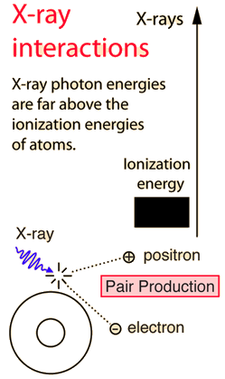
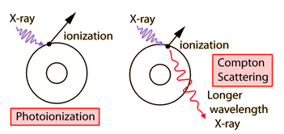
Radiation matter interaction
X-Ray Interaction
Since the quantum energies of x-ray photons are much too high to be absorbed in electron transitions between states for most atoms, they can interact with an electron only by knocking it completely out of the atom. That is, all x-rays are classified as ionizing radiation. This can occur by giving all of the energy to an electron (photoionization) or by giving part of the energy to the electron and the remainder to a lower energy photon (Compton scattering). At sufficiently high energies, the x-ray photon can create an electron positron pair.

